Slide 1
Discount Information
Searching and Sharing Platform
Xinyun Chen chen.xinyu@husky.neu.edu
Xingyao Wu wu.x@husky.neu.edu
Github : https://github.com/gurge3/scala_final_project

Slide 2
Design Methodology
& Code Structure
PART 1

Slide 3
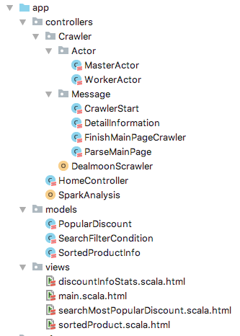
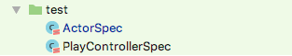
Project Composition
Web Crawler
AKKA
Data
Analysis
Data
Visualization
SPARK
PLAY

Slide 4
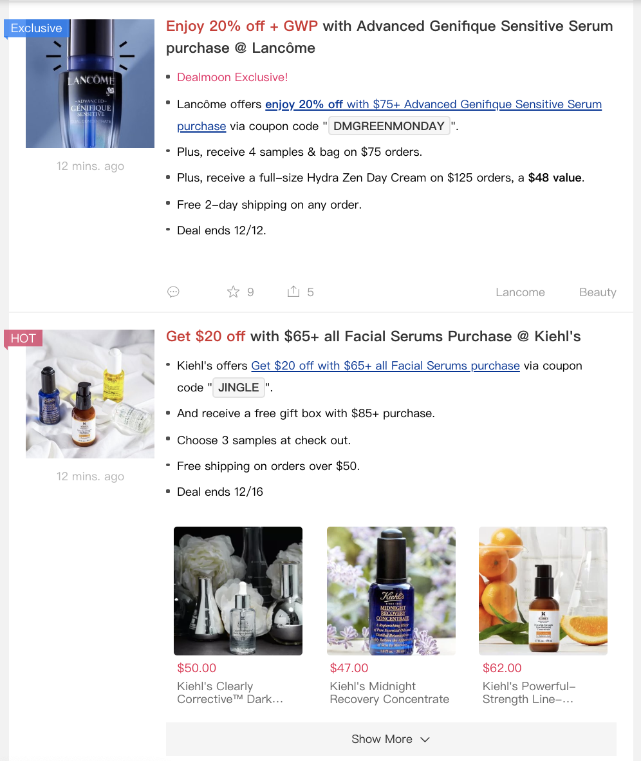
Web Page Structure Introduction
Categories :
"Clothing-Jewelry-Bags" -> 80 "Beauty" -> 80 "Electronics-Computers" -> 88 "At-Home" -> 94 "Baby-Kids" -> 66 "Sports-Outdoors" -> 19
Deal Information Item
In Index Page
01
Containing deal description, detail page link, platform, favorites, shares, comments
Data Dimension :
Detail Page URL Discount Description Platform
Product Title
Discounted Price
Original Price
Category
Favorites
Shares
Comments
Discounted Product Item
In Detailed Page
Containing discounted product name, brand, original price, discounted price
02

Slide 5
Actor and Task Structure
Task 1: Create Child Worker
Task 2: Index Page Crawler
Task 3: Detailed Deal Information Crawler
Create and assign one child worker for each page of six categories，
the total number of worker is Sum(pages)
Get and save the detailed information page URLs and deal description by crawling the index page
After finishing the main page crawler task, worker will be assigned to crawler detailed discounted product information
01
02
Parse Main Page
03
Master
Actor
Finish Main Page
Worker
Actor
04
Crawler Start
05
Parse Detail Information
08
06
07
Scheduler : every 5 mins

Slide 6
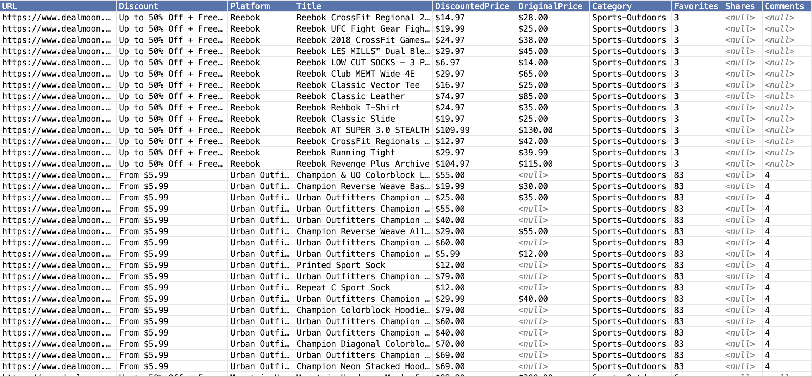
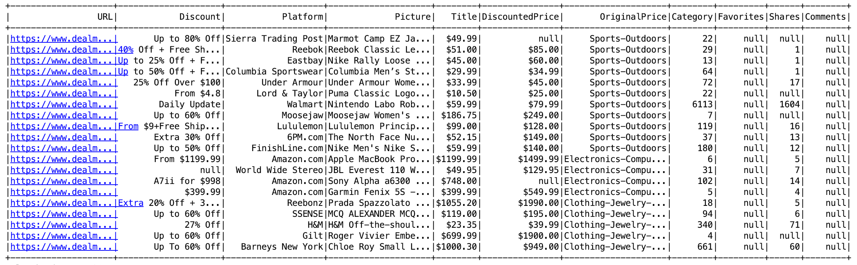
Data Structure & Spark Processing
Data Scale : 50101
Operations :
CSV File
Filter
Sort
Order
Select
Sum
Map
Reduce
Count
Distinct
Collect
Take
Limit
Spark Data frame

Slide 7
PART 2
User Stories & Unit Test

Slide 8
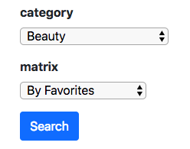
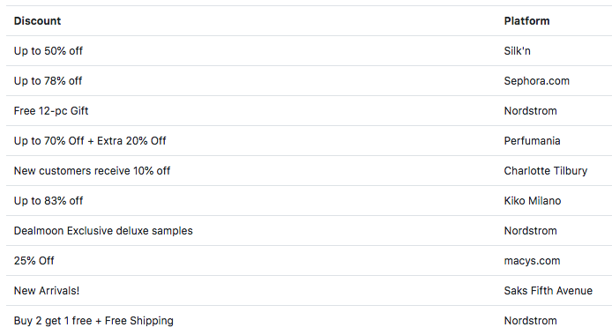
User Story 1
Search Most Popular Deal
Select Category and Matrix
Get Top 10 Deals Description and Platform sorted by matrix

Slide 9
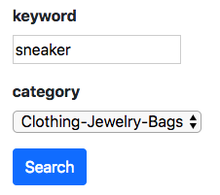
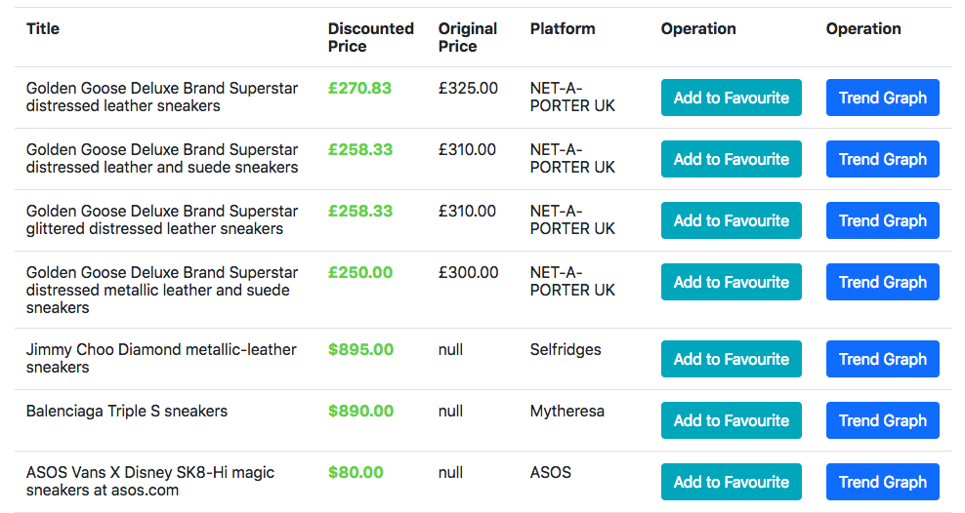
User Story 2
Search Discounted Product
Select Keyword & Category
Get All Discounted Products Contains Keyword

Slide 10
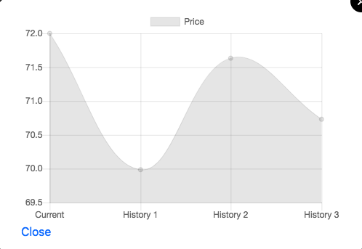
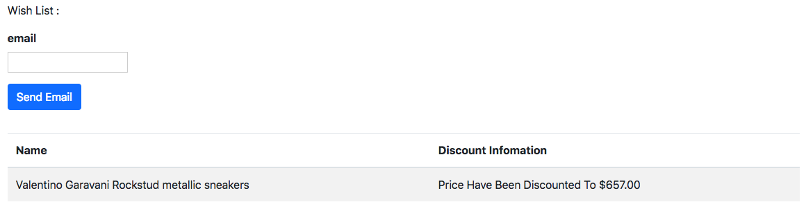
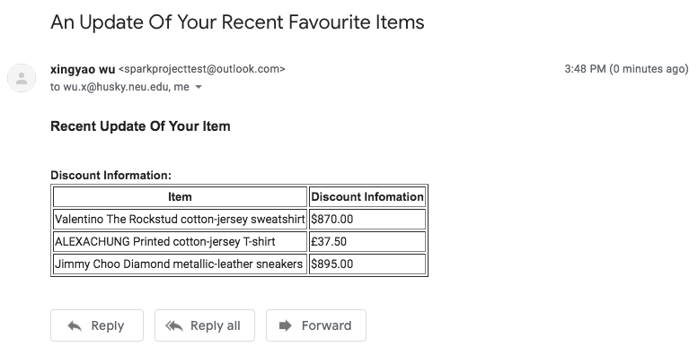
User Story 3
Get Trend Graph and Follow of Discounted Product
View the Trend Graph of Price
Add to Wish List and send the email

Slide 11
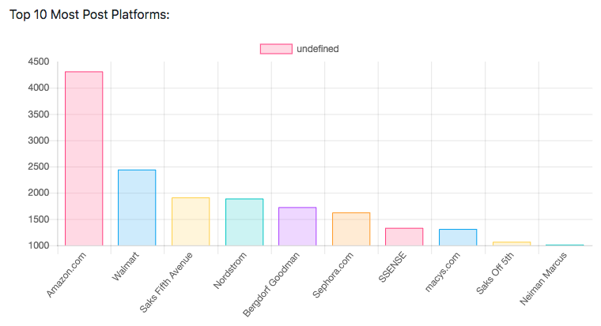
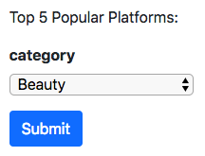
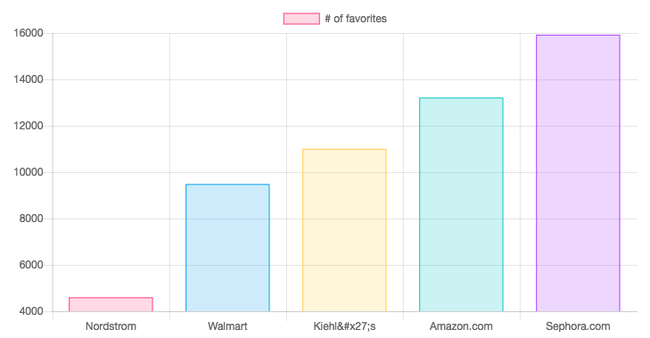
User Story 4
Get Statistics Information on Most Published and Popular Platforms
Top 10 Most Published Platforms
Top 5 Most Popular Platforms by Categories

Slide 12
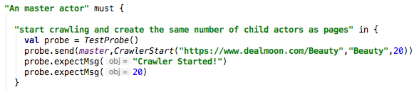
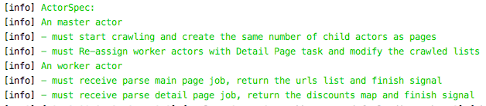
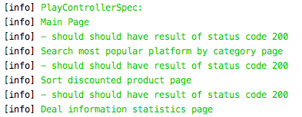
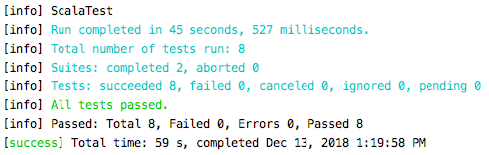
Unit Test Cases
Word Spec Like
format
Actor Test
Based on Messages Transferring
Actor
Controller Test
Based on HTML pages rendering
Akka Test kit
Controller
Scala Play Test
Test Result

Slide 13
PART 3
It is Demo Time !

Slide 14
THANKS FOR WATCHING!

